Slide 1
Visual Intelligence for Personalized Travel Planning
Ashwin Kumar Yedte (2023AC05628)

Slide 2
Problem Statement & Motivation
Problem Statement:
  Existing visual intelligence systems for travel and image search lacks ability to convert user uploaded images into theme aware, geo optimized and finance optimized based recommendations.
  Example: Which sea-beach destinations best match my visual preferences, during this time of year, within my budget?”
Gap:
  Interpretation of multiple uploaded travel images
Extraction and aggregation of dominant visual themes
Identification and inference of geo-locations
Recommendation of similar destinations optimized for theme, location, and cost

Slide 3

System Design and Architecture
Front End/Presentation Layer
Text Search Image Upload
Primary
Destination
Recommended
Destinations
VLM Intelligence &
Decision layer
Image Analysis
Destination
Identification
Theme Extraction & Aggregation
Similar Destinations/
Optimizations
Database layer
Destination Catalogue DB
Destinations Vector DB
Offers DB
Visual Language
Encoding Layer
Image Feature Extraction
Embedding Generation
Geo Tagging
Geo Tagged Visual Descriptors

Slide 4
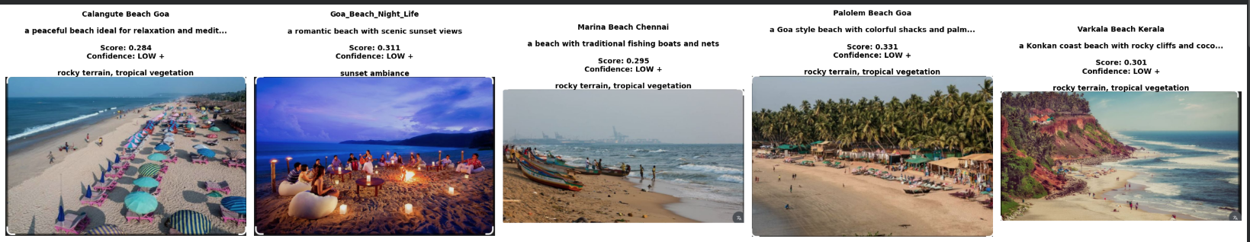
VLM Intelligence & Decision Layer
Image Analysis
Image Validations
Pre-process
CLIP Visual Encoding
Similarity Computation
Theme Selection and Ranking
Multi-Image aggregation and Scoring

Slide 5
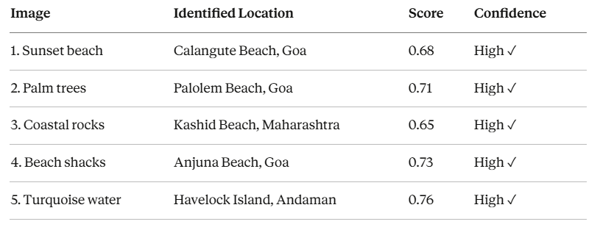
VLM Intelligence & Decision Layer
Destination Identification
Results of Image Analysis
Image Retrieval Destination DB
Land Mark & CF Scoring
Visual Gallery Update
User Communication

Slide 6
VLM Intelligence & Decision Layer
Theme Extraction & Aggregation
Results of Image Analysis
Per Image Theme match
Theme Freq Analysis
Weighted Scoring
Consistency matching
Dominant Theme Identification
  Example:
  Dominant Theme = "tropical beach" (score: 0.41, appears 5/5 images, consistency: 78% High), Secondary = "peaceful relaxation" (score: 0.35, appears 3/5 images)
  Interpretation: User prefers serene tropical beach destinations with high confidence

Slide 7
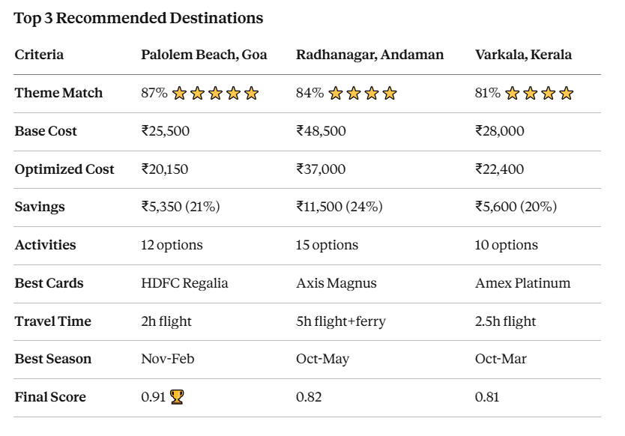
VLM Intelligence & Decision Layer
Similar Destination and Offer optimizations
User Preference
Similar ‘K’ Destinations
Destinations Offer/activities
Rank Top 100
Visual Gallery
New user Filters

Slide 8
VL Encoding Layer
Land Marks Dataset
Image Feature Extraction
Embedding
Generation
Geo Tagging
Geo Tagged Visual Descriptors
Geo-Tagged Offers
Destination Catalogue DB
Destination Vector DB
Offers DB
Stores Destination Metadata
(name, location, activities, best season, accessibility info)
Stores Destination Vector DB
stores CLIP embeddings (512-dim vectors)
Stores Destination Merchant Offers

Slide 9
Conclusions & Recommendations
Core Achievements:
Multi-Image Analysis: CLIP based model could be successfully used for multi image analysis and similarity detection and extraction for theme based user preference, optimized travels.
Key Innovation: Prompt extraction from images could be used for multi dimensional preference understanding that could not be achieved easily with Text based image searches.
Geo Tagged Visual Intelligence Geo Tagging of prompt and Visual descriptors can be immensely useful for destination discovery within priorities set by user
Recommendations:
1. Enhance the intelligence for more diverse and aggregated themes from single destination
2. Real considerations on integration of site images and prompt generation for same geo tags.

Slide 10
Literatures and References:
References
[1] A. Radford et al., "Learning Transferable Visual Models From Natural Language Supervision," Proceedings of the 38th International Conference on Machine Learning (ICML), vol. 139, pp. 8748–8763, Jul. 2021. [Online]. Available: https://arxiv.org/abs/2103.00020
[2] Y. Chen, L. Wang, and Z. Liu, "MyVLM: Personalizing Vision-Language Models for User-Specific Queries," European Conference on Computer Vision (ECCV), 2024. [Online]. Available: https://arxiv.org/abs/2403.14599
[3] H. Zhao, X. Li, and T. Xu, "VisionReward: Fine-Grained Multi-Dimensional Human Preference Learning for Image and Video Generation," arXiv preprint arXiv:2412.21059, Dec. 2024. [Online]. Available: https://arxiv.org/abs/2412.21059
[4] C. Wang, L. Feng, and P. Li, "A Multimodal Travel Route Recommendation System Leveraging Visual and Textual Representation," Frontiers in Computer Science, vol. 6, pp. 1–12, Nov. 2024. [Online]. Available: https://www.frontiersin.org/articles/10.3389/fcomp.2024.1249185
[5] A. Dosovitskiy et al., "An Image is Worth 16x16 Words: Transformers for Image Recognition at Scale," International Conference on Learning Representations (ICLR), 2021. [Online]. Available: https://arxiv.org/abs/2010.11929
[6] Google Landmarks Dataset V2, "A Large-Scale Benchmark for Instance-Level Recognition and Retrieval," IEEE/CVF Conference on Computer Vision and Pattern Recognition (CVPR), pp. 2575–2584, 2020. [Online]. Available: https://github.com/cvdfoundation/google-landmark
[7] S. Antol et al., "VQA: Visual Question Answering," IEEE International Conference on Computer Vision (ICCV), pp. 2425–2433, 2015. [Online]. Available: https://arxiv.org/abs/1505.00468

